Slide 1
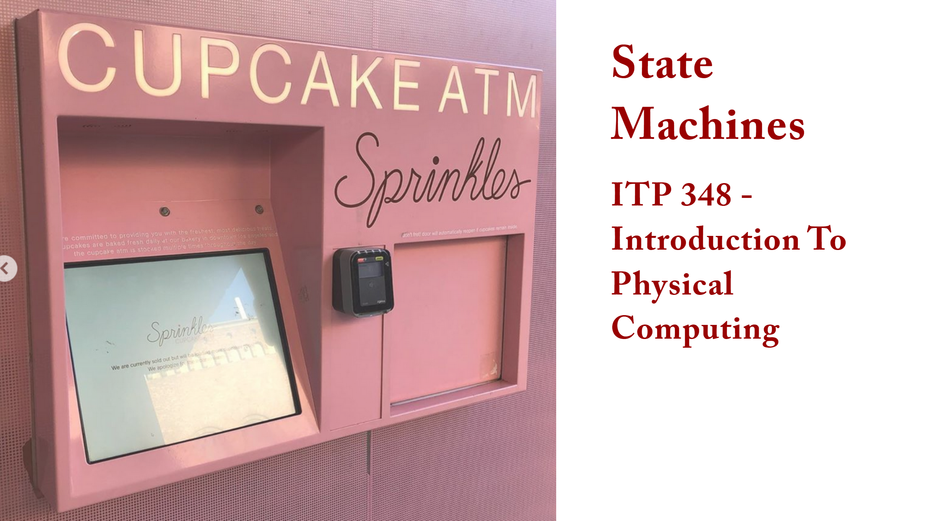

Slide 2
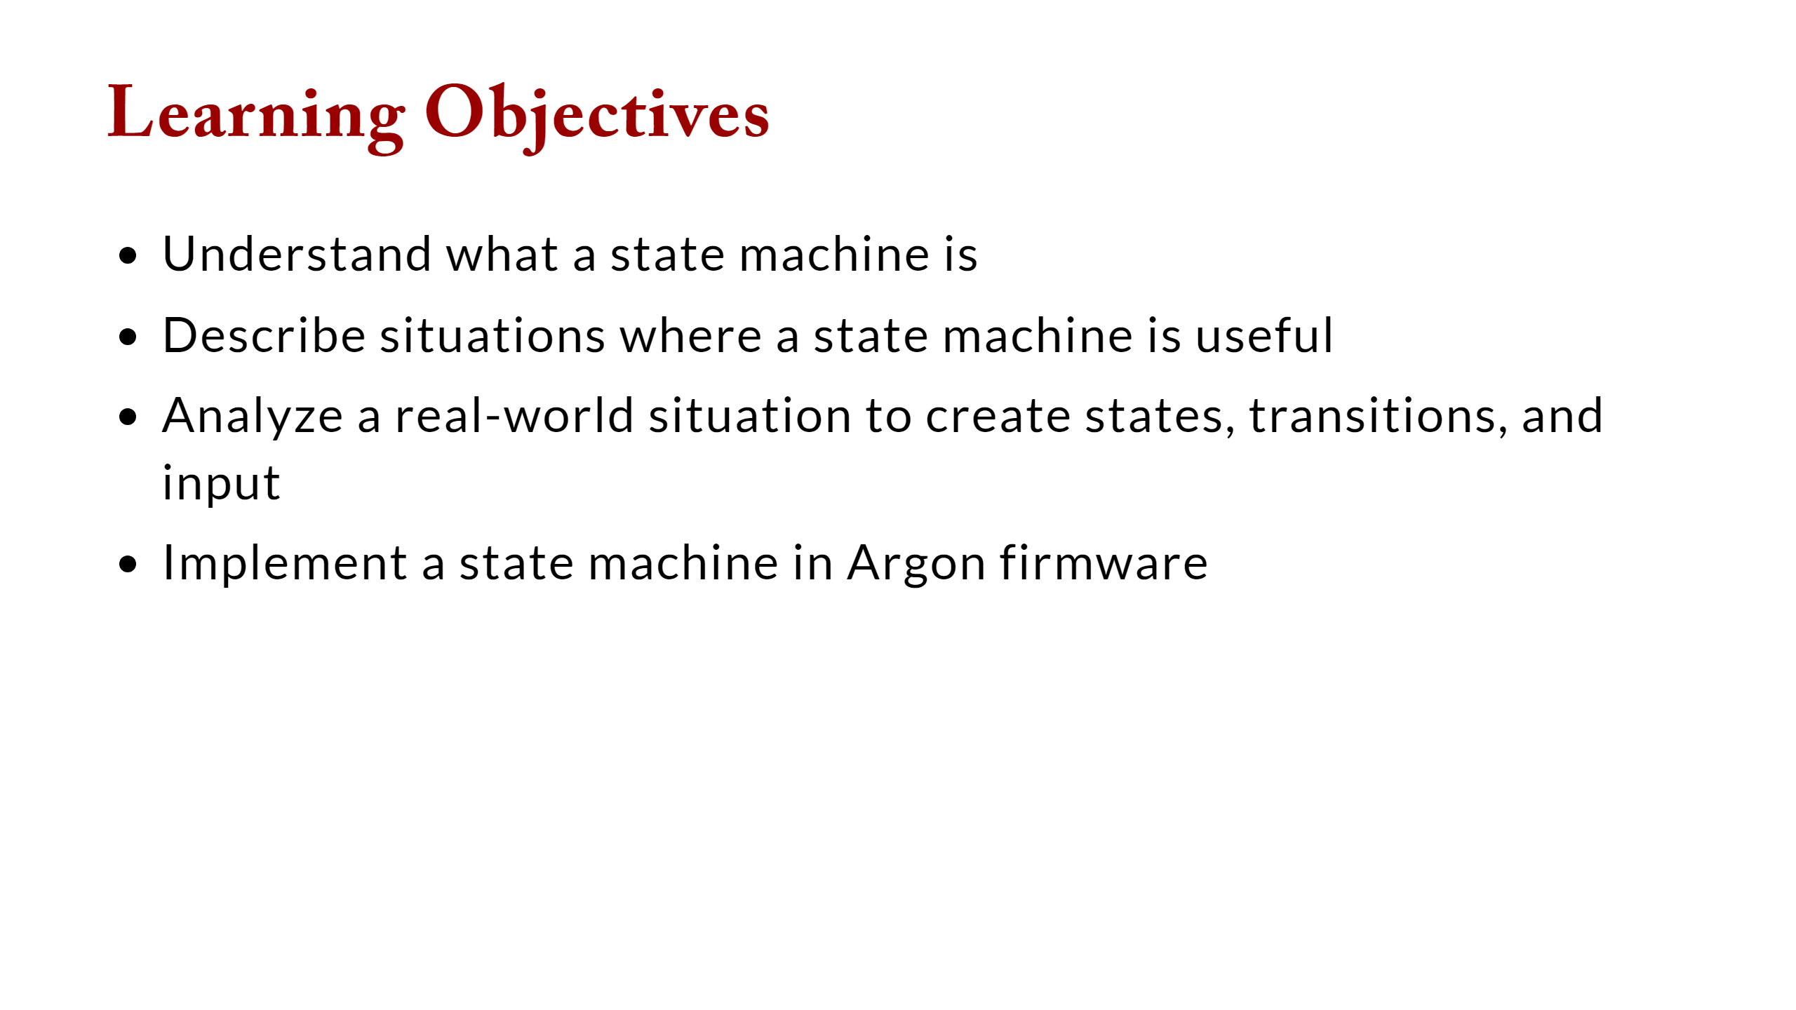

Slide 3
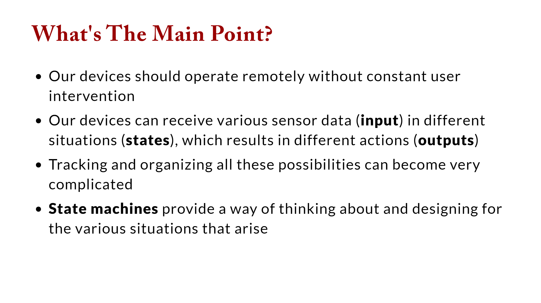

Slide 4
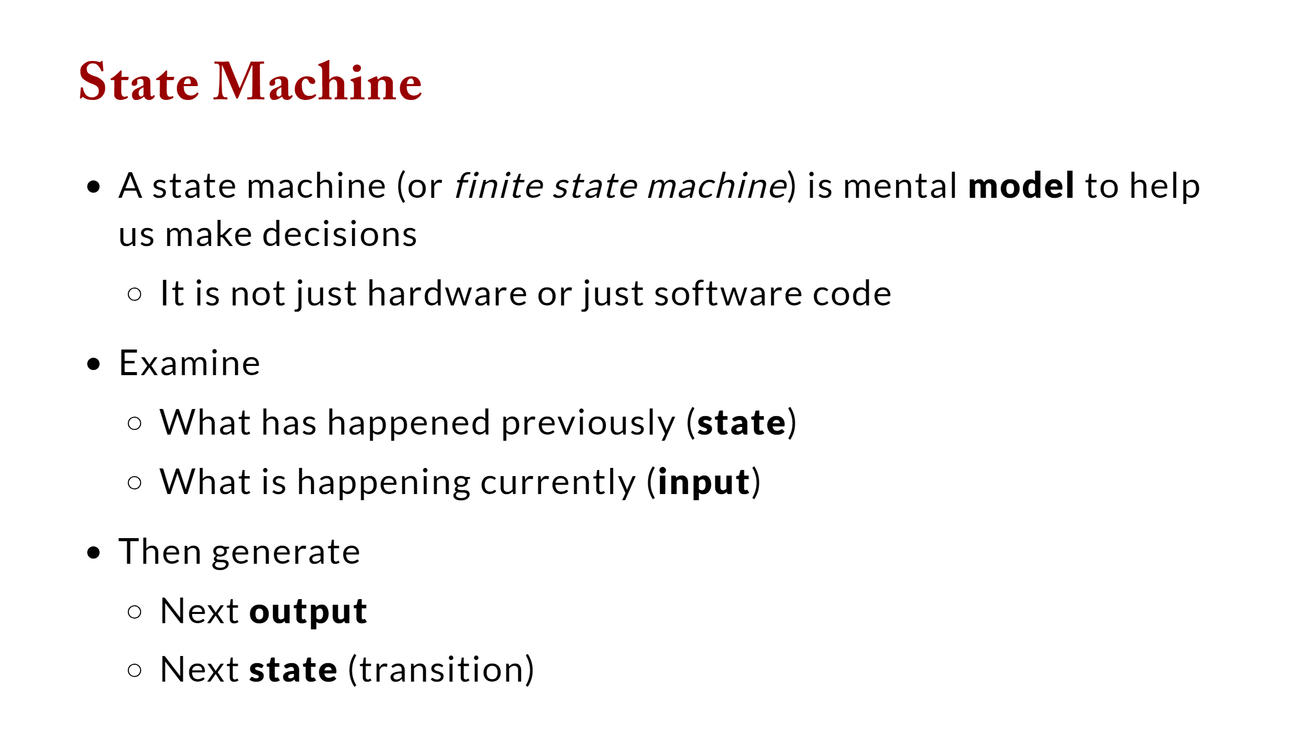

Slide 5
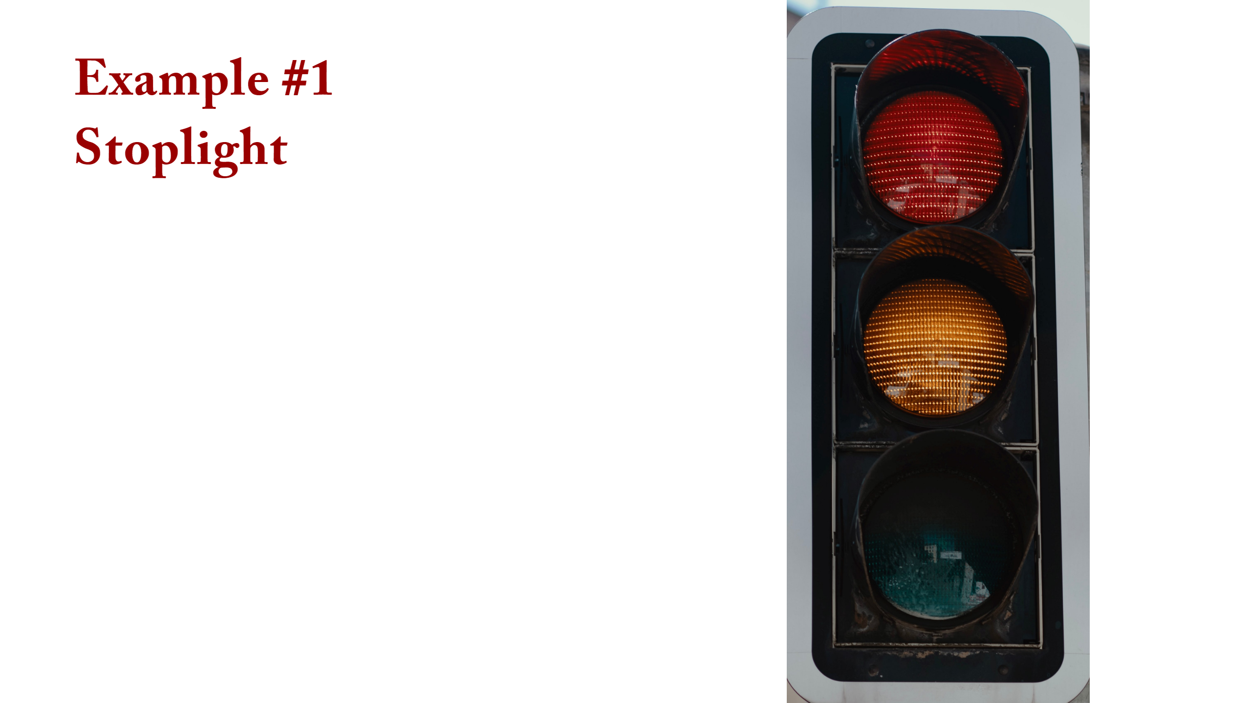

Slide 6
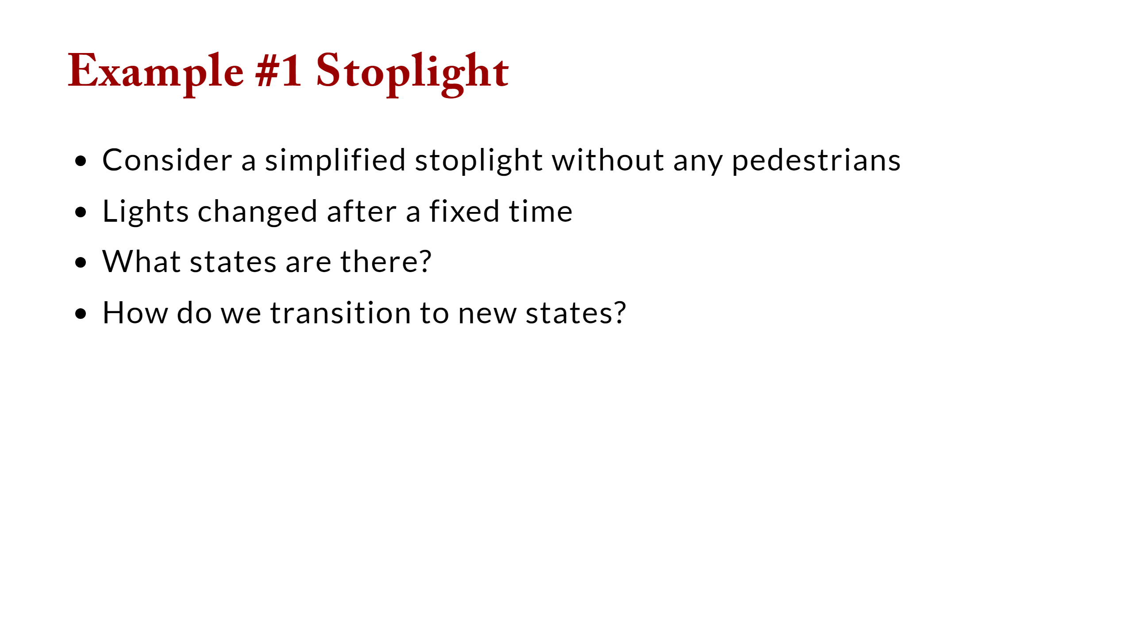

Slide 7
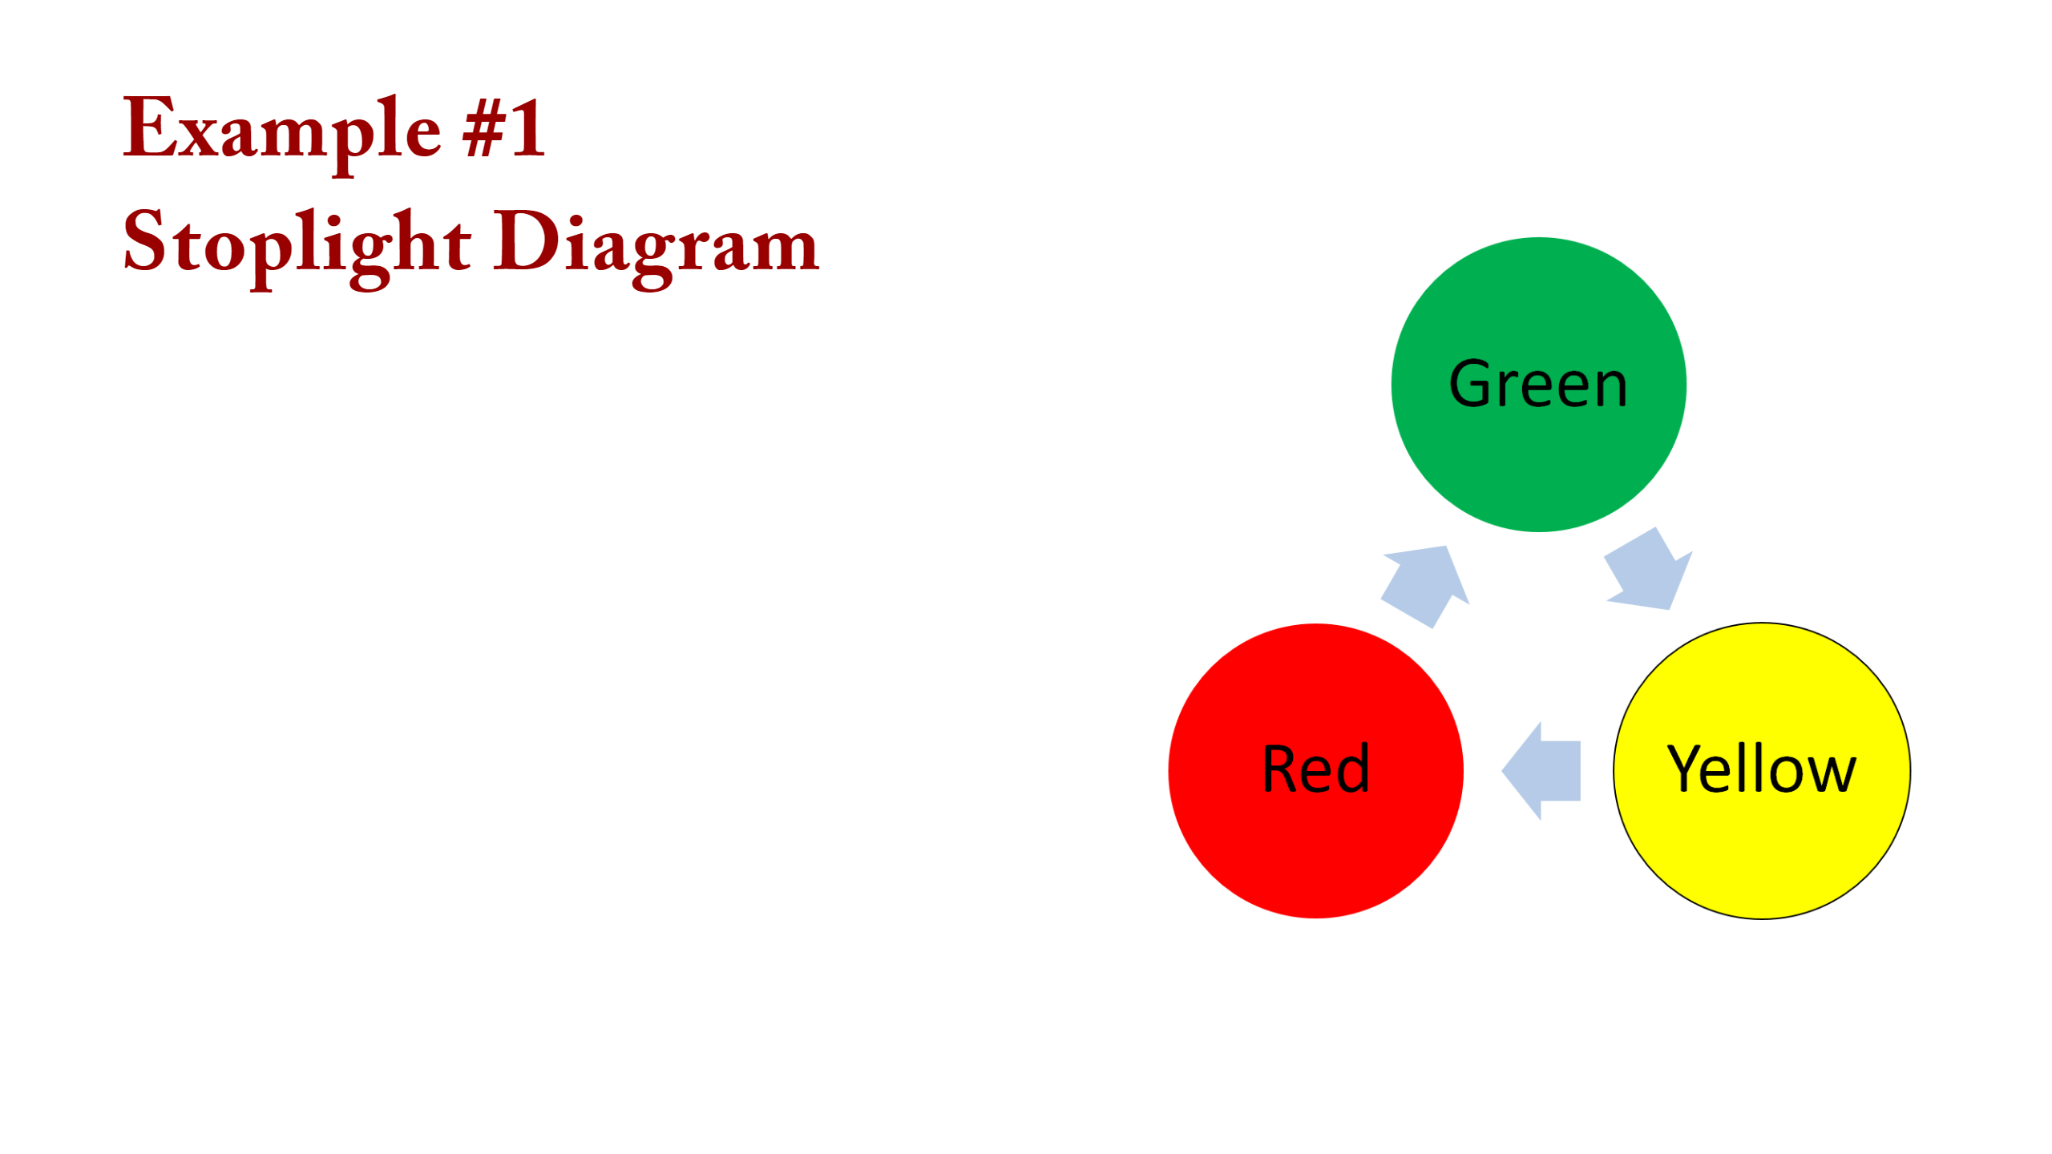
Notes:
draw state diagram

Slide 8
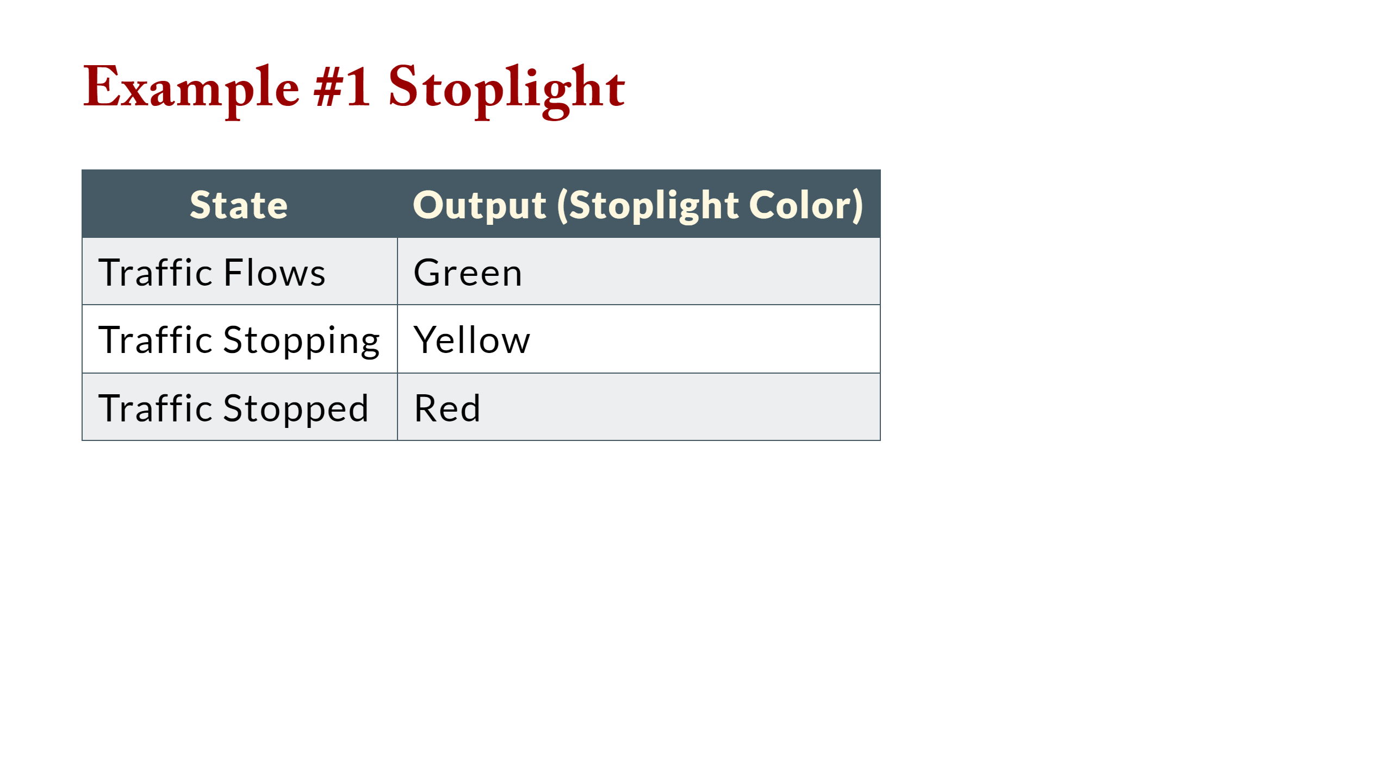

Slide 9
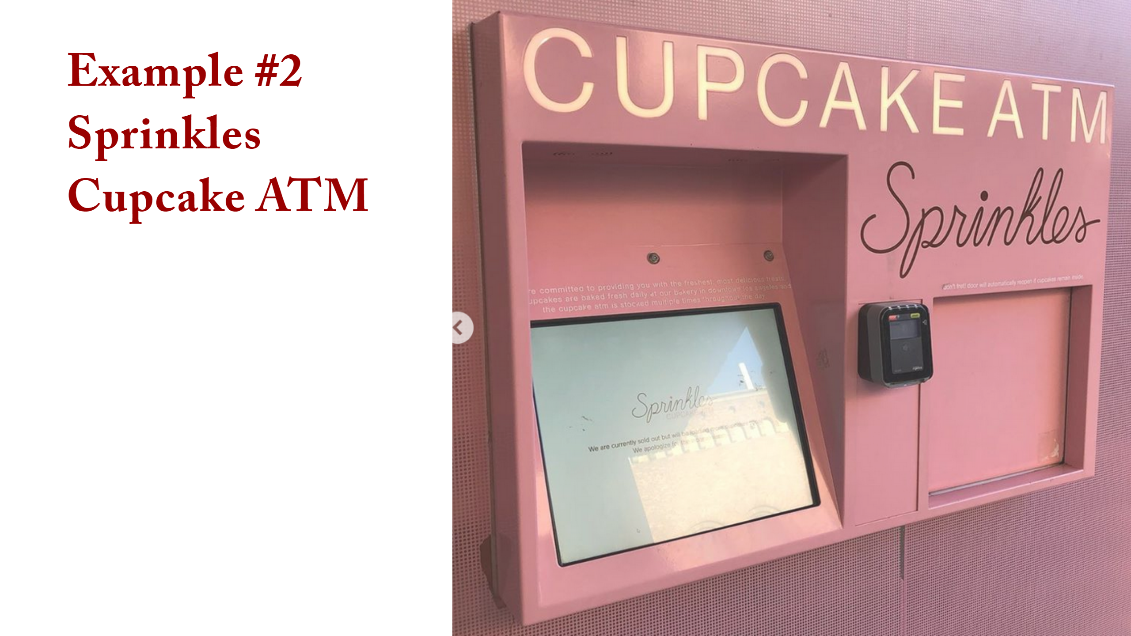
Notes:
<img src="lecture_finite_state_machines.assets/image-20200303153612762.png" alt="image-20200303153612762" style="width:800px;" /> draw state diagram idle +start+ display display +select+ process display -cancel- idle display |selection empty| display process +credit card valid+ dispense process |credit card valid| process dispense |cupcake remains| dispense dispense +cupcake taken| idle

Slide 10
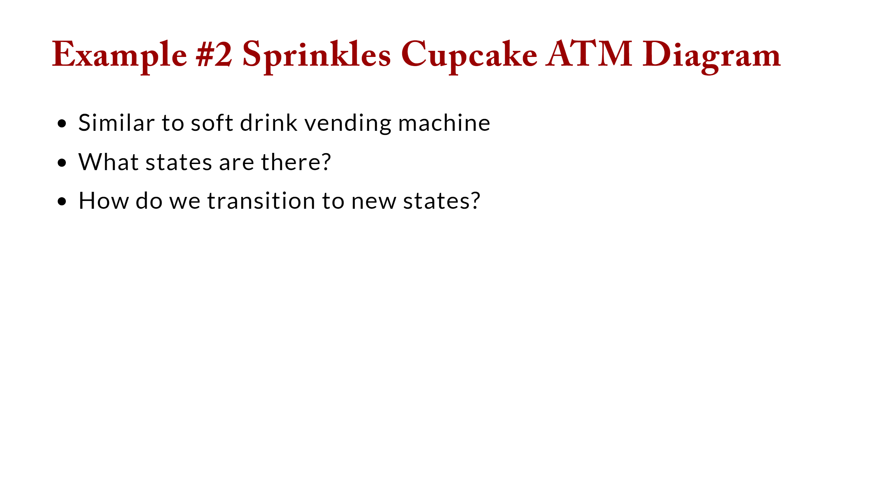

Slide 11
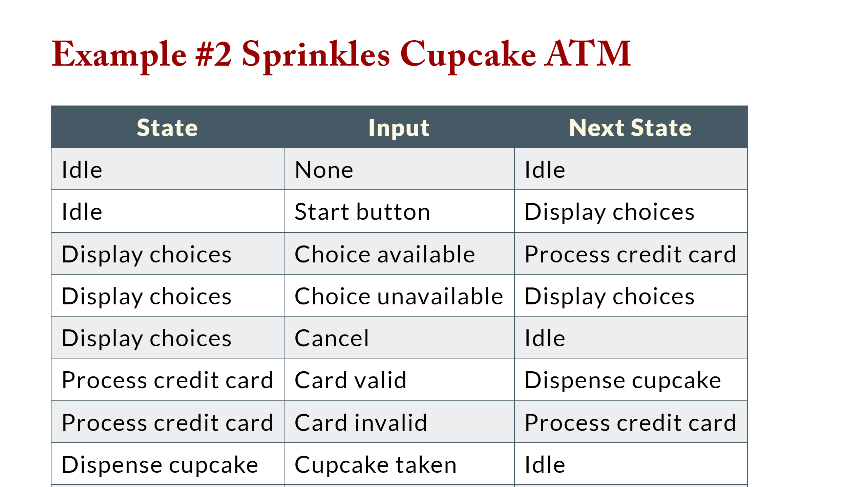

Slide 12
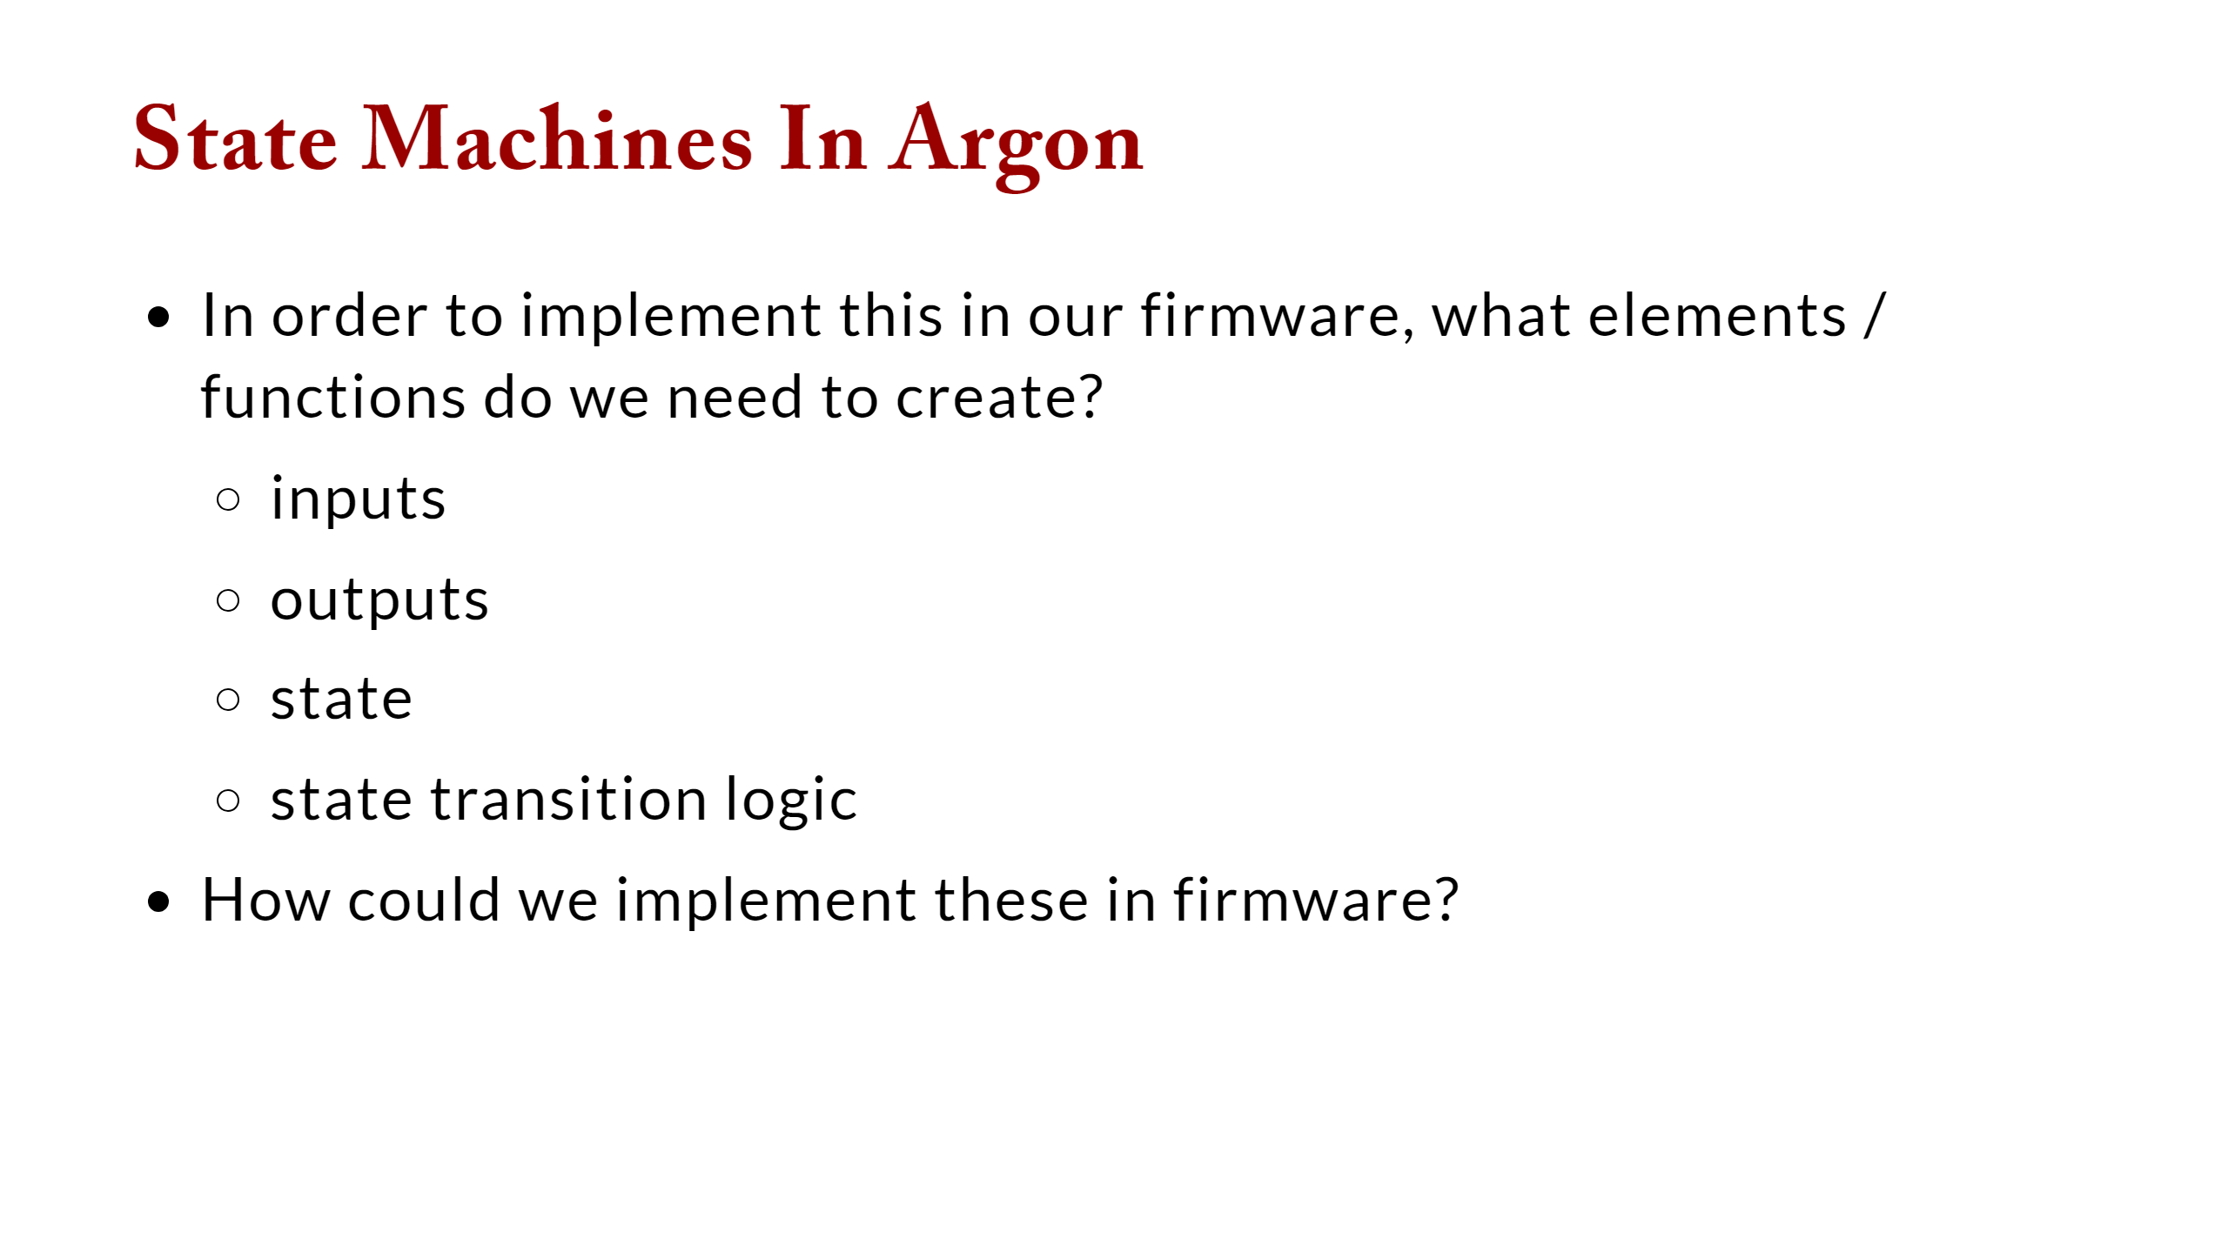

Slide 13
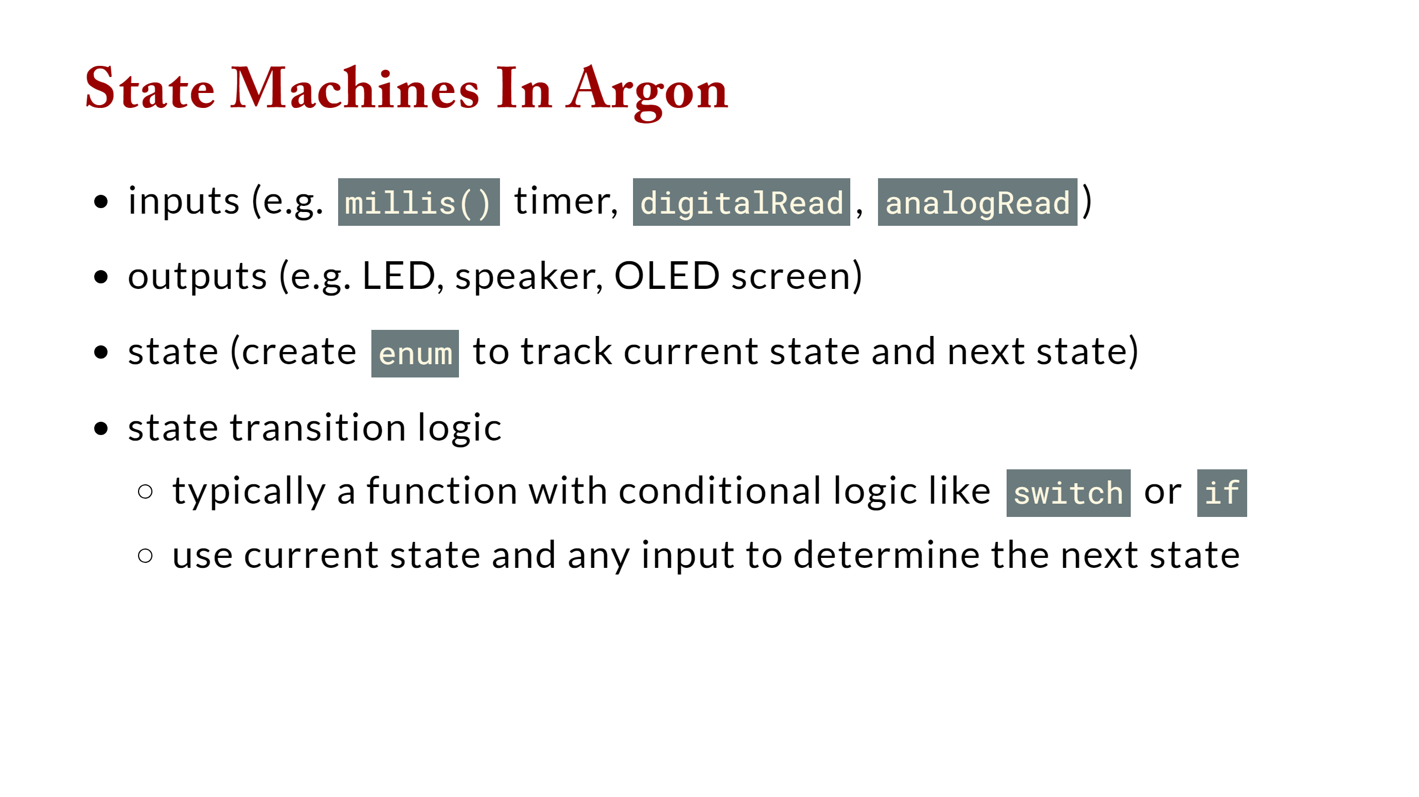

Slide 14
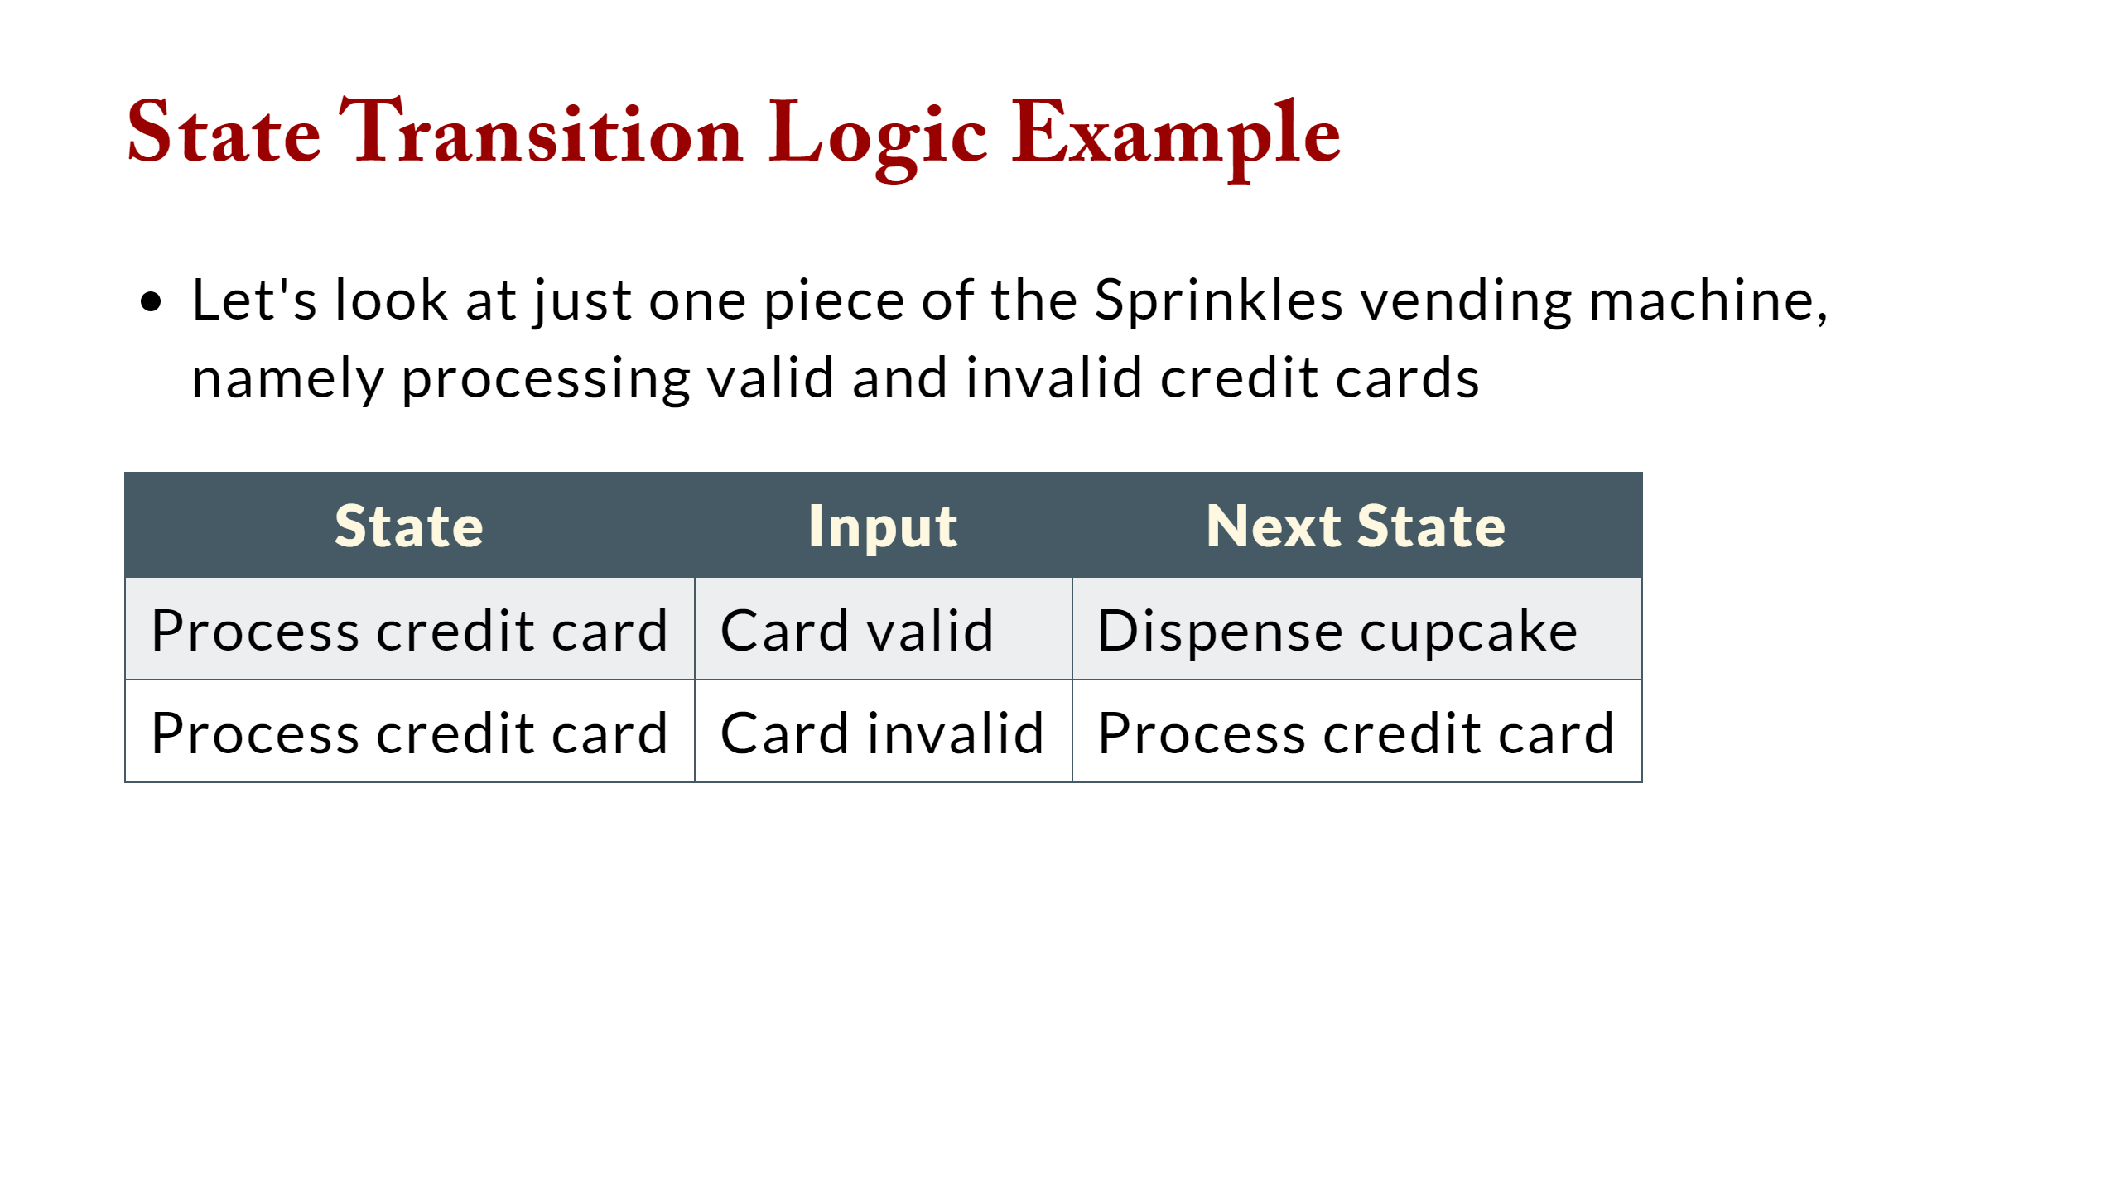

Slide 15
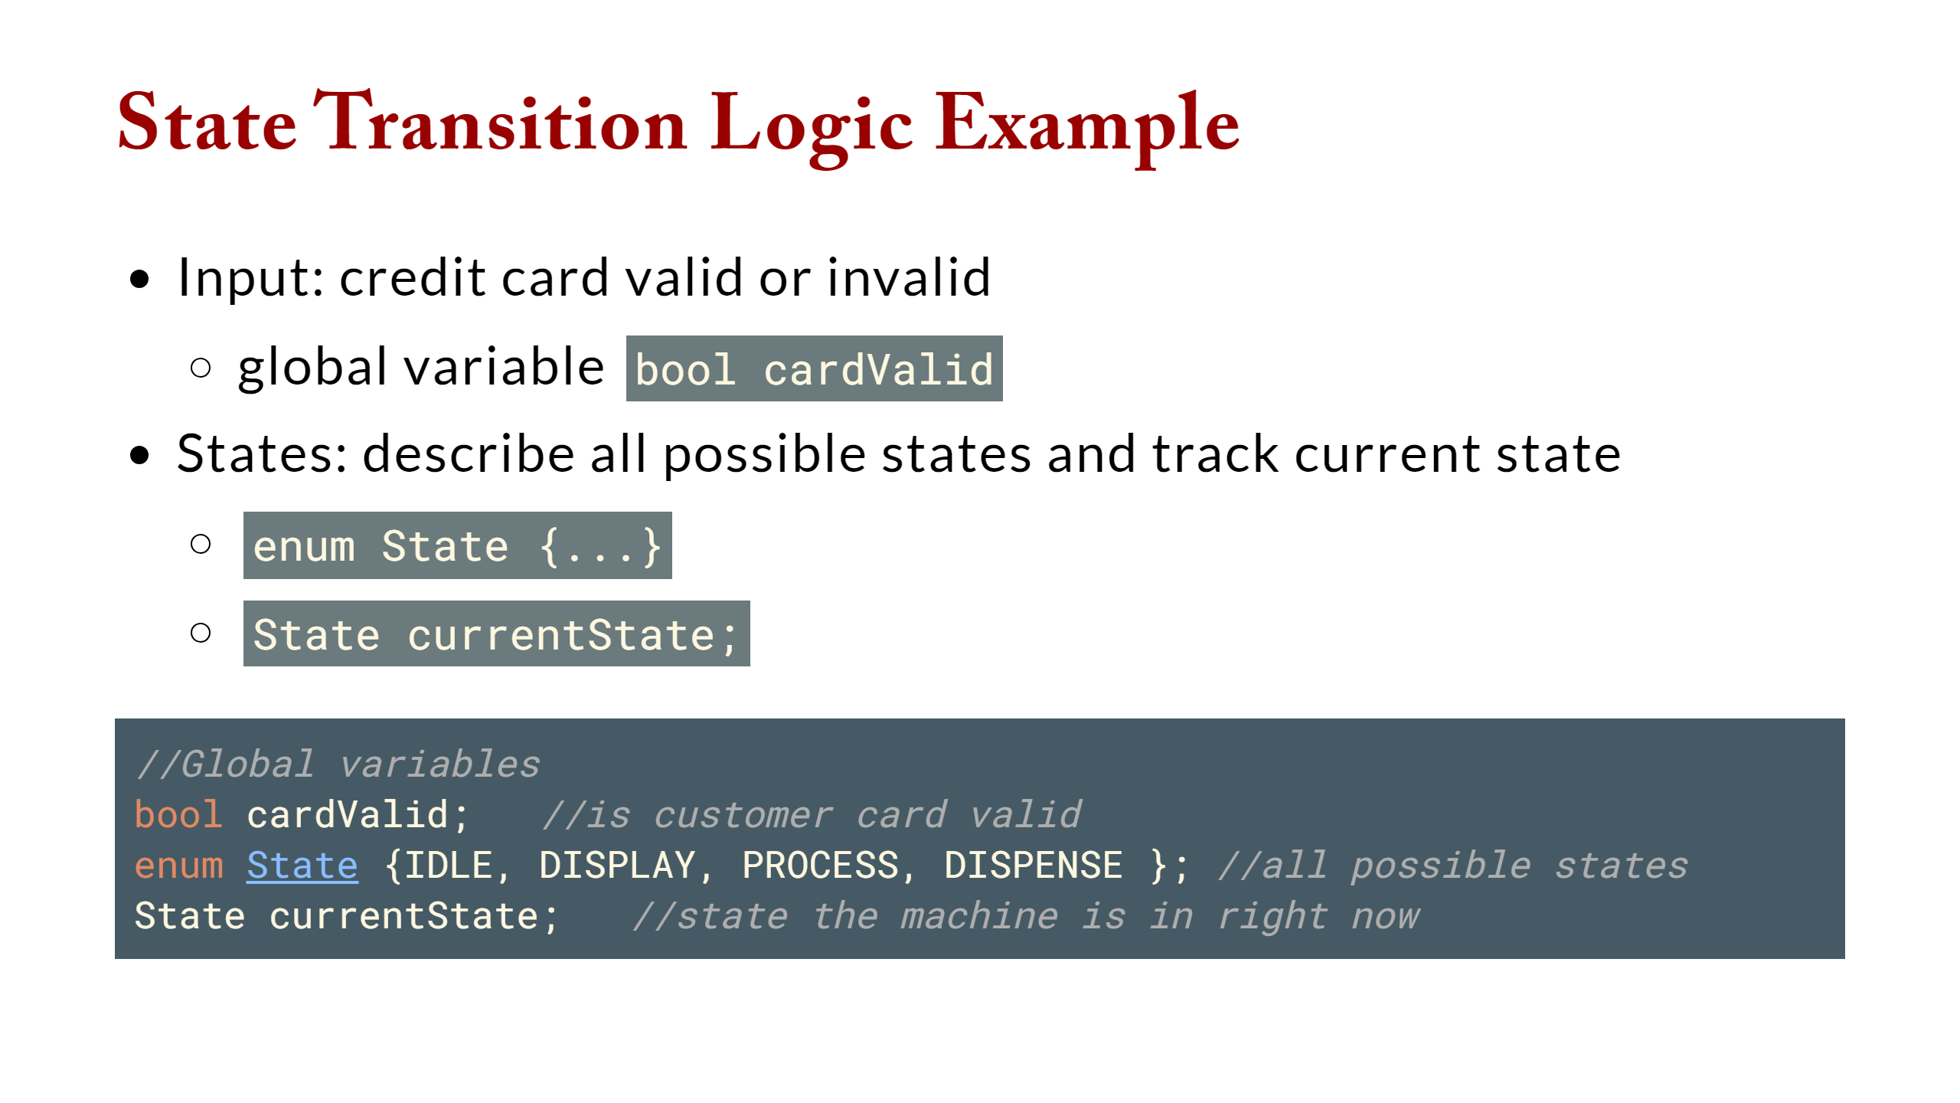

Slide 16
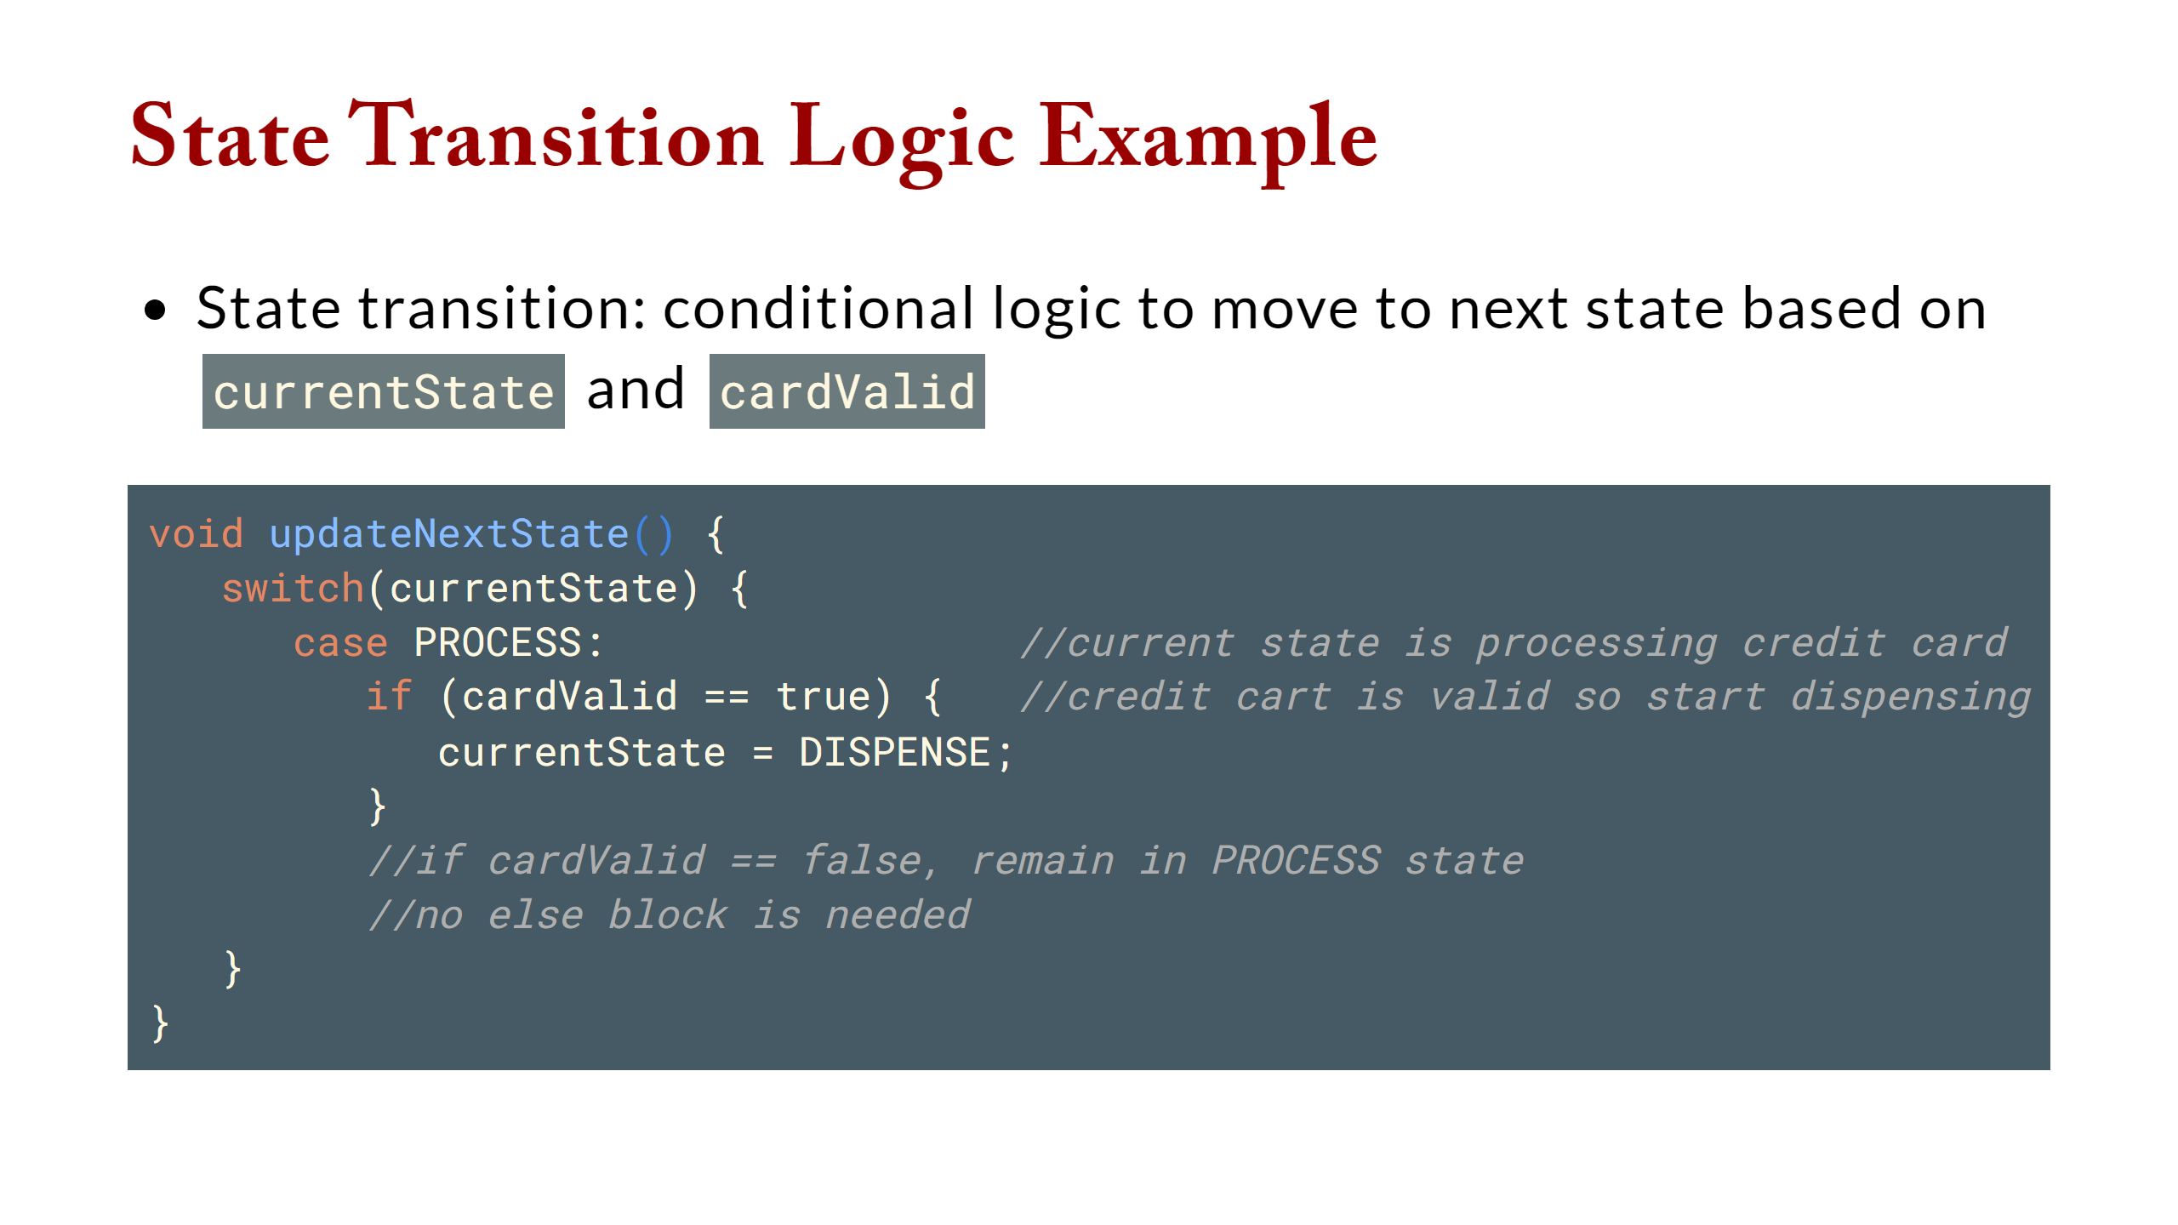

Slide 17
